Slide 1
AI-Based Canteen Food Demand Predictor Using Artificial Intelligence and Machine Learning
Smart Food Demand Prediction for Efficient & Sustainable Canteens

Slide 2


Overview
Abstract
Problem Statement
Objectives
Introduction
Existing System- Limitations
Proposed System/Methodology
Hardware & Software Requirements
Feasibility Analysis
Module Descriptions
Advantages of Modular Approach

Slide 3
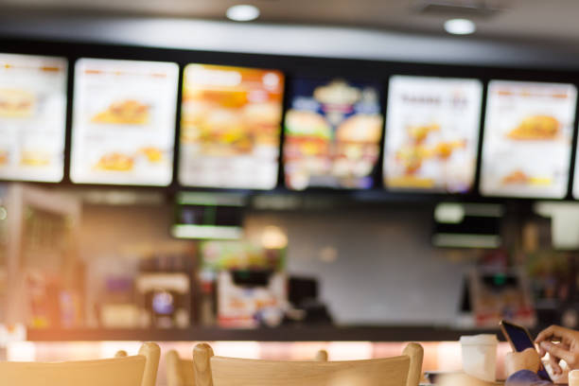
Abstract
In most college canteens, food is often either wasted or insufficient to meet student demand due to inaccurate estimation of required quantities. The AI-Based Canteen Food Demand Predictor project aims to overcome this issue by forecasting the amount of food needed each day using Artificial Intelligence and Machine Learning techniques. The system leverages historical data, including student strength, past sales, weekdays, seasonal trends, and special occasions, to generate accurate demand predictions. Algorithms such as Linear Regression, Random Forest, and LSTM are utilized for model training and validation. By comparing predicted and actual consumption, the system continuously improves its accuracy. This project helps minimize food wastage, control costs, and enhance canteen efficiency, promoting sustainable and data-driven food management across educational institutions.

Slide 4
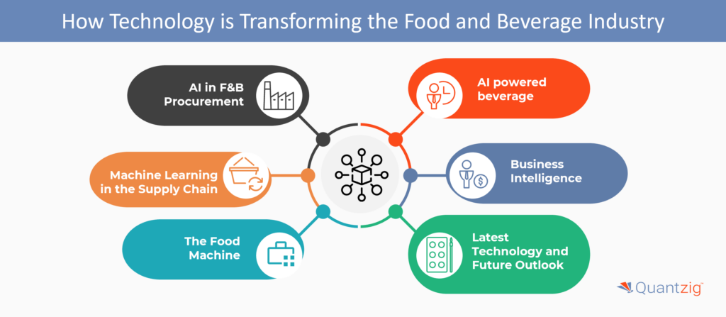
Problem Statement
College canteens often face difficulties in estimating the right amount of food to prepare each day. Manual prediction leads to either excess food, causing wastage, or shortages, resulting in student dissatisfaction. Important factors like student strength, weekdays, and special events are often ignored. To overcome this, an AI-based system is needed to accurately predict daily food demand using historical data and machine learning techniques, reducing waste and improving canteen efficiency.

Slide 5

To accurately predict daily food demand in the college canteen using AI and ML techniques.
01
To analyze historical data such as past sales, student strength, weekdays, and special events for better forecasting.
02
Objectives
03
To reduce food wastage and manage resources efficiently.
To assist canteen staff in planning and decision-making through data-driven insights.
04
05
To promote sustainable and cost-effective canteen management.

Slide 6
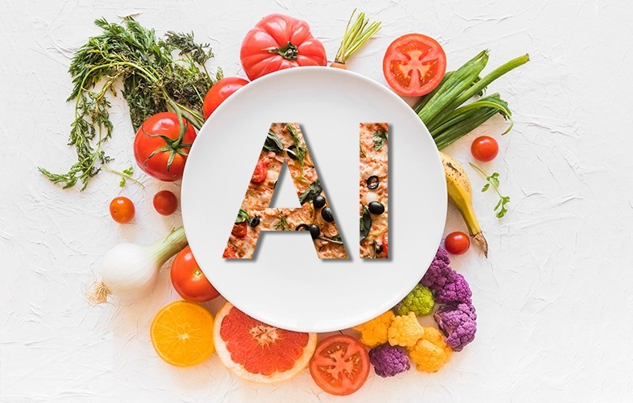

Introduction
College canteens often face challenges in estimating the daily quantity of food to prepare. Overestimation leads to food wastage, while underestimation causes shortages and student dissatisfaction. These inefficiencies affect both operational costs and service quality.
The AI-Based Canteen Food Demand Predictor aims to address this problem by leveraging Artificial Intelligence (AI) and Machine Learning (ML) techniques to forecast daily food demand accurately. The system analyzes historical data, including student attendance, past sales, weekdays, seasonal trends, and special events, to predict the quantity of each food item required.
The predictive model utilizes algorithms such as Linear Regression, Random Forest, and Long Short-Term Memory (LSTM) networks to generate accurate forecasts. By comparing predicted demand with actual usage, the system continually improves its accuracy. This solution helps canteen managers optimize resource usage, reduce food waste, control costs, and promote sustainable food management.

Slide 7

Limitations of the Existing System
Existing System
1
Relies solely on guesswork to estimate food demand
In most college canteens, food demand is estimated manually by staff based on past experience or intuition. This approach lacks systematic analysis and often results in inaccurate predictions. Consequently, either excess food is prepared, leading to wastage, or insufficient food is made, causing shortages and student dissatisfaction. Critical factors such as weekdays, student strength, seasonal variations, and special events are generally ignored, making operations inefficient and resource-intensive.
2
Frequently causes food wastage due to overproduction
3
Leads to shortages when demand is underestimated
4
Lacks data-driven insights to guide future planning
5
Inefficient use of resources, time, and labor

Slide 8
Proposed System / Methodology
The proposed system is an AI-driven food demand prediction model that uses historical data and contextual factors to forecast the daily requirement for each menu item. Unlike the manual estimation method, this system adopts a structured, data-driven approach to improve accuracy and operational efficiency.
Data
Collection
Data Preprocessing
Feature Selection & Extraction
Model Training & Testing
Forecasting & Dashboard Integration
Gather historical data including daily sales, student attendance, weekdays, seasonal trends, weather, and special events.
Clean the dataset by handling missing values, duplicates, and encoding categorical variables to ensure data quality.
Identify key features such as day of the week, student strength, past sales, and event indicators that influence food demand.
Train machine learning models like Linear Regression, Random Forest, and LSTM using training data and evaluate their performance on test data.
Generate daily food demand forecasts and display insights on a user-friendly dashboard for canteen managers.

Slide 9

Proposed System with Advantages
Highly accurate demand predictions using AI and ML.
Reduces food wastage and optimizes cost efficiency.
Continuously improves with new data for real-time adaptability.
User-friendly interface for easy decision-making by canteen administrators.

Slide 10

Hardware and Software Requirements
Hardware Requirements
Processor: Intel i3/i5 or higher (for smooth ML execution)
RAM: Minimum 4 GB (8 GB recommended for faster model training)
Storage: 250 GB HDD/SSD (for datasets and project files)
System Type: 64-bit Operating System
Graphics: Basic integrated graphics (GPU optional for LSTM training)

Slide 11
Software Requirements
Operating System: Windows 10/11 or Linux (Ubuntu recommended for ML)
Programming Language: Python 3.x
Libraries/Frameworks:
NumPy – numerical operations
Pandas – data preprocessing
Matplotlib / Seaborn – data visualization
Scikit-learn – Linear Regression & Random Forest
TensorFlow / Keras – LSTM implementation
IDE / Development Tools: Jupyter Notebook, PyCharm, or VS Code
Database (Optional): MySQL or SQLite for storing historical data
Version Control (Optional): GitHub for collaboration and backup

Slide 12
Feasibility Analysis
Technical
Feasibility
Economic Feasibility
Operational Feasibility
Social
Feasibility
Uses common hardware (laptops/PCs with 4–8 GB RAM) and open-source tools like Python, Scikit-learn, and TensorFlow. No specialized equipment is needed.
Primarily relies on free software libraries, making it cost-effective. Reduces food wastage and shortages, saving operational costs.
Easy-to-use interface requires minimal training and integrates smoothly into existing canteen workflows.
Promotes sustainability by reducing food waste, ensuring fair distribution, and encouraging eco-friendly practices.

Slide 13
Module Descriptions
Gathers historical data including daily sales, student attendance, weekdays, seasonal trends, weather, and special events.
Ensures sufficient and relevant data is available for model training.
Data Collection Module
Cleans the data by handling missing values, duplicates, and irrelevant entries.
Encodes categorical variables and normalizes data to improve model accuracy.
Data Preprocessing Module
Identifies key factors influencing food demand such as day of the week, student strength, past sales, and event indicators.
Extracted features are used as inputs for machine learning models.
Feature Selection & Extraction Module

Slide 14
Module Descriptions
Implements machine learning algorithms like Linear Regression, Random Forest, and LSTM to train prediction models.
Splits data into training and testing sets to evaluate performance and ensure accuracy.
Model Training & Testing Module
Uses trained models to predict daily demand for each food item.
Continuously updates predictions based on feedback and new data.
Forecasting & Prediction Module
Displays demand forecasts and insights in a user-friendly interface.
Helps canteen managers make informed decisions, reduce waste, and optimize resources.
Dashboard & Reporting Module

Slide 15
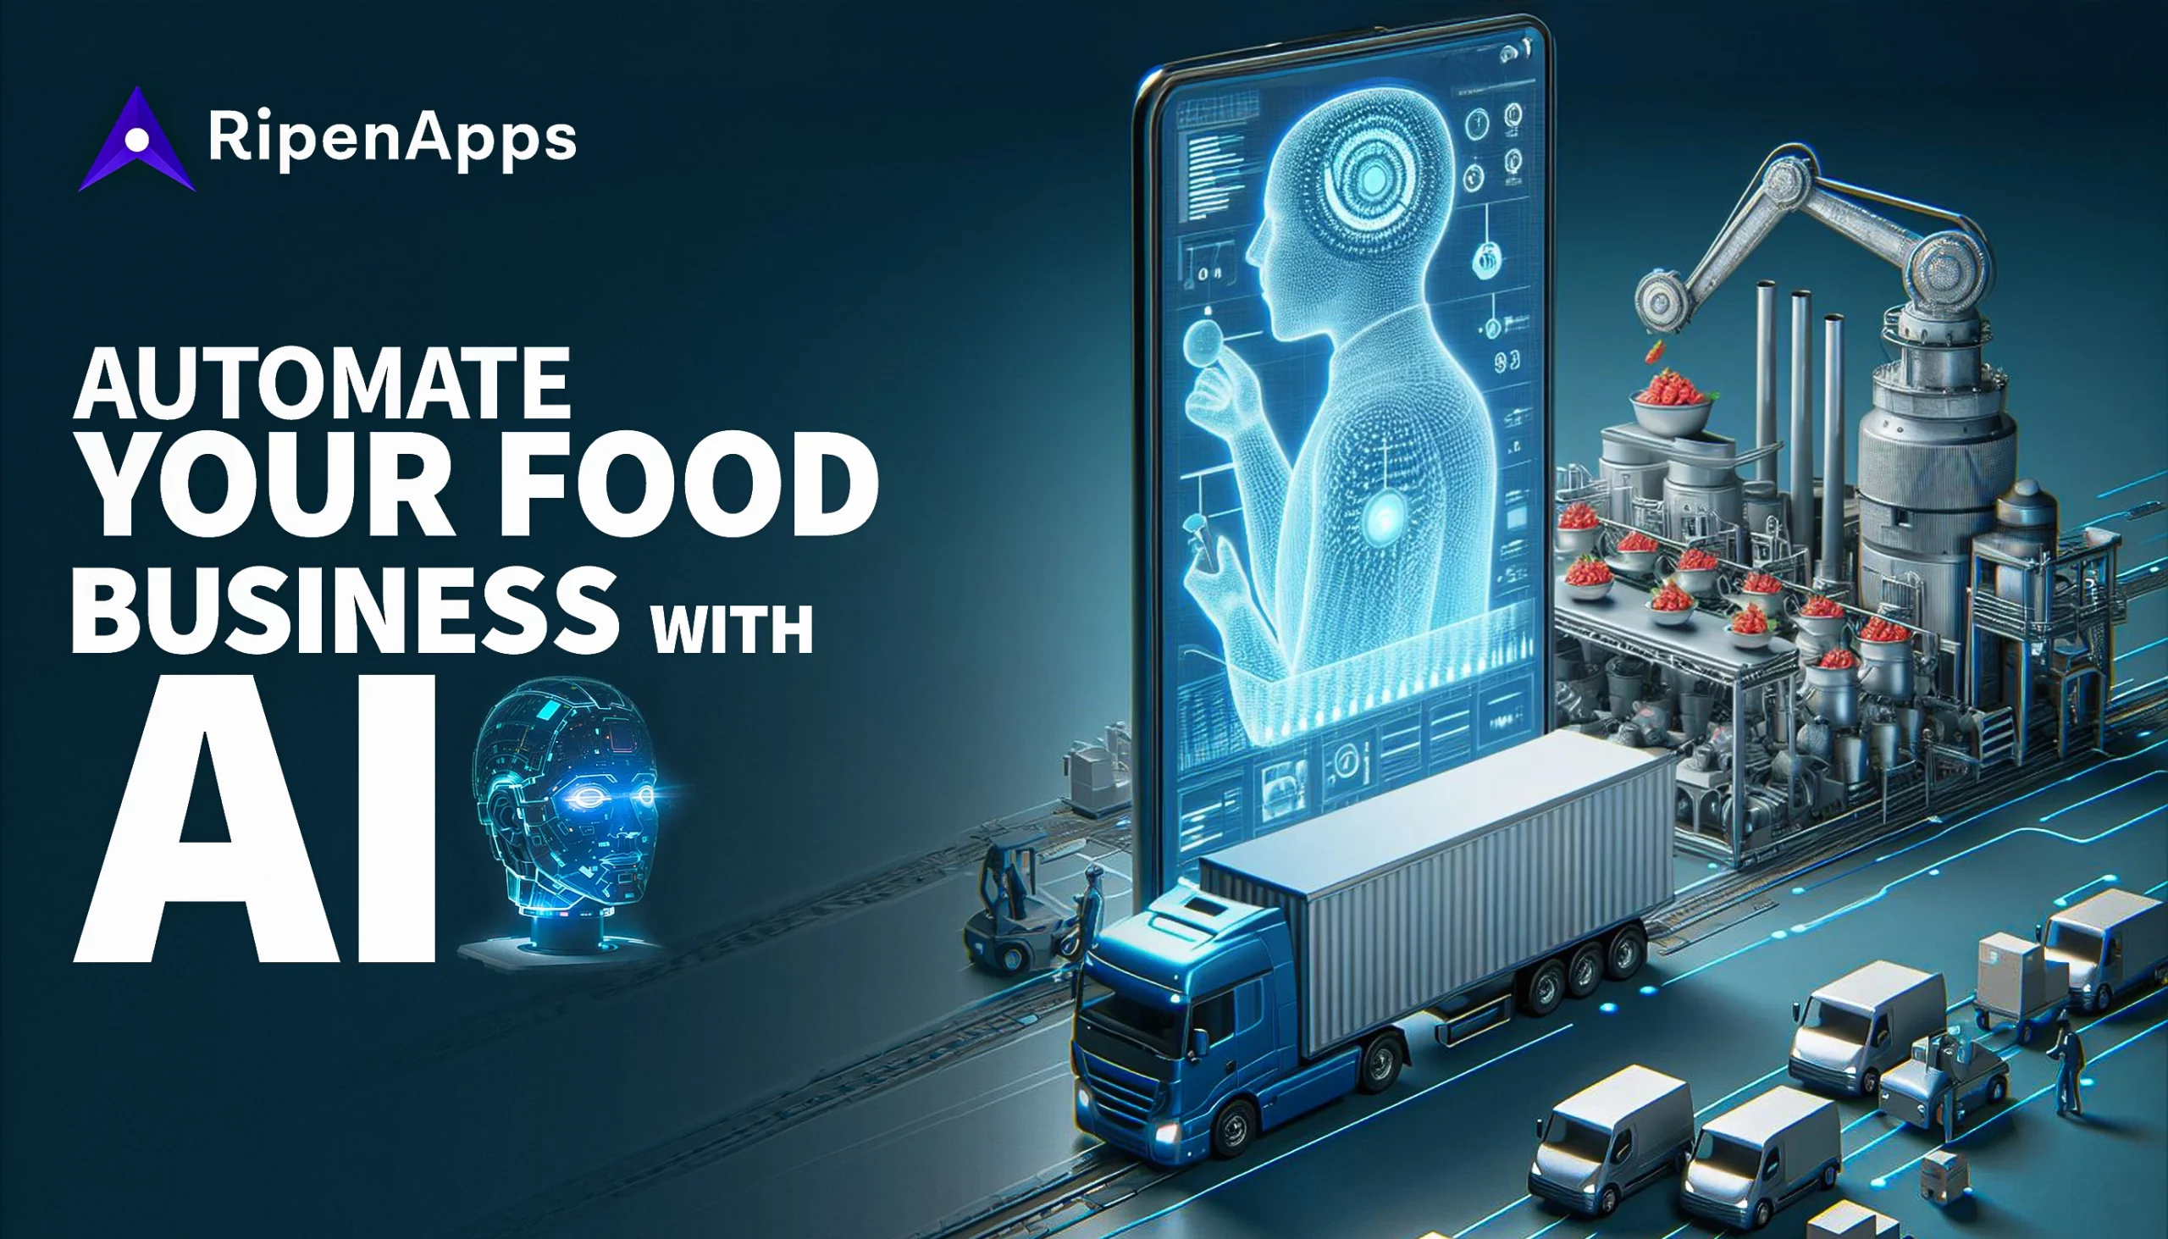

Advantages of Modular Approach
Accurate, data-driven predictions for daily food preparation.
Reduced wastage and improved cost efficiency.
Real-time updates and continuous learning from new data.
Easy-to-use interface for seamless operational management.

Slide 16

Conclusion
The AI-Based Canteen Food Demand Predictor efficiently forecasts daily food demand using AI and ML techniques, analyzing factors like past sales, student attendance, weekdays, seasonal trends, and special events. By providing accurate predictions, it helps reduce food wastage, optimize resources, and control costs. The system continuously improves with new data and offers a user-friendly interface for canteen managers to make informed decisions. This project demonstrates the practical benefits of AI in enhancing operational efficiency, sustainability, and overall satisfaction in college canteens.

Slide 17

THANK YOU!
Hemanth Kumar P

